Slide 1

Near-Optimal Network Design with
Selfish Agents
Elliot Anshelevich Anirban Dasgupta Éva Tardos Tom Wexler
Presented by Federico Peconi during
Scolarship Erasmus+ at Technische Universität München
Seminar: Selected Topics in Efficient Algorithms
Informatik Department
Notes:
1

Slide 2
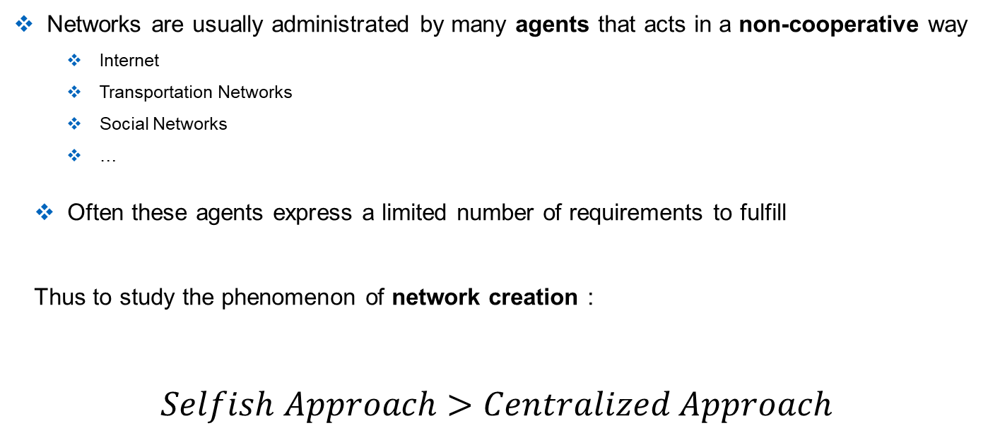
Motivations
Networks are usually administrated by many agents that acts in a non-cooperative way
  Internet
  Transportation Networks
  Social Networks
  …
  Often these agents express a limited number of requirements to fulfill
  Thus to study the phenomenon of network creation :
  $$Selfish Approach>Centralized Approach$$
More Realistic!
Notes:
Think of two people that want to connect on the internet or a social network , or to many bo

Slide 3
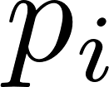

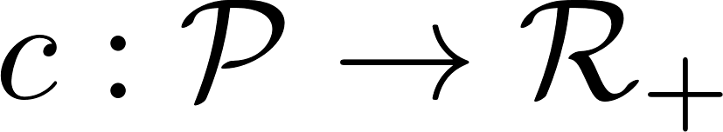
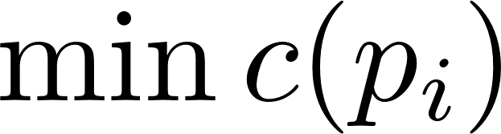
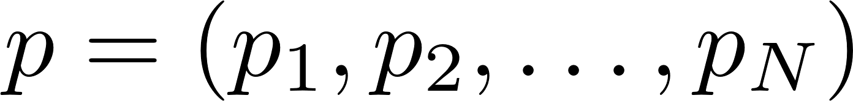
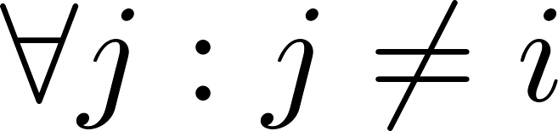
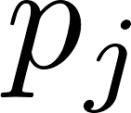
Algorithmic Game Theory
The problem is modelled with a game
  Each player has a set of rules that he has to follow
  Let to be the strategy adopted by the player during the game:
  we define the cost function to be the function that assign a value
  to each valid strategy
  Each player seek to
Set of valid strategies
Nash Equilibrium
We say that the system (game) is in the state called Nash Equilibrium when no one of the players involved has an incentive to deviate from his payments.
I.E.: If is fixed, then is the best possible strategy for player
3

Slide 4

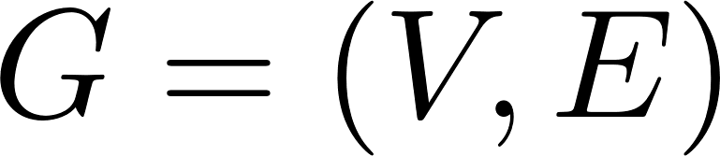
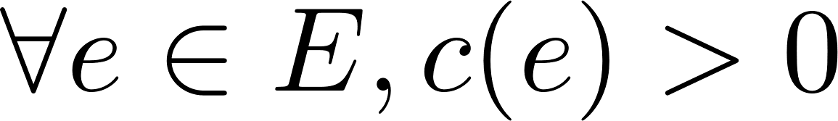
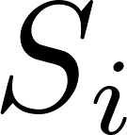
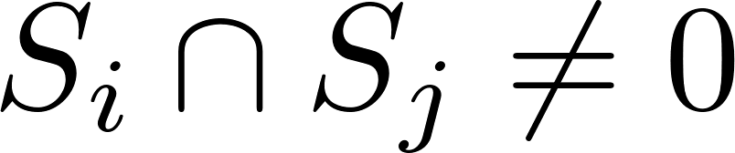
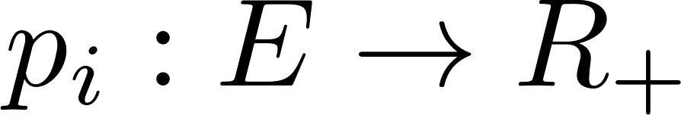
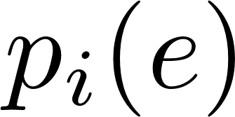

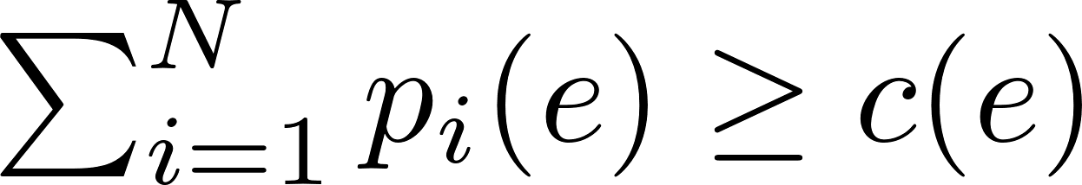
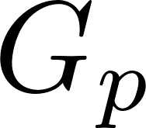
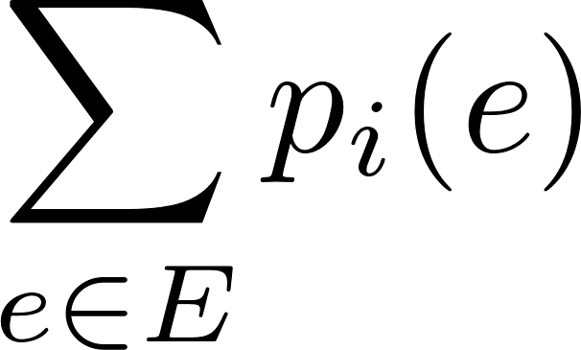
The Connection Game
We can then adapt the previously introduced concepts to our scenario and define the
following connection game:
Let be the numbers of players and an undirected graph w/ non-negative weighted edges
Each player has a set of terminals nodes that he needs to connect ( )
The strategy of player is a payment function , such that is how much he contributes to edge
  Edge is considered bought if and call the graph composed by all the bought edges (hence the cost of an edge can be shared between agents!)
  A player that does not connect all of his terminals occurs in an infinite penality, otherwise it simply pays the sum of his contributions:
  which seeks to minimize

Slide 5
An Example
S₁
T₃
S₂
T₂
S₃
T₁

Slide 6
An Example
S₁
T₃
S₂
T₂
S₃
T₁

Slide 7
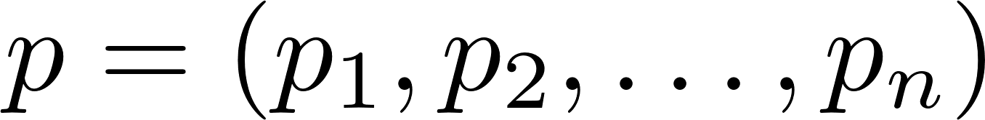

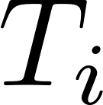
Some Properties of the Connection Game
Finding the centralized optimum of the connection game corresponds to the classical network problem of finding the minimum generalized Steiner Tree
  Note: It is not always the case that the optimum is reached by the game (later)
  Let be a NE over an instance of our defined game, then we have:
    That is a forest
    That, let be the minimum spanning Tree over his terminals then contributes to and only to the edges of
    Each edge is either fully paid or not at all
(If not then a cycle)
(If stops paying for edges outside , still connected)
(Trivial)
What else can we say about Nash Equilibria? For instance, can there be more than one equilibrium for a given graph?

Slide 8
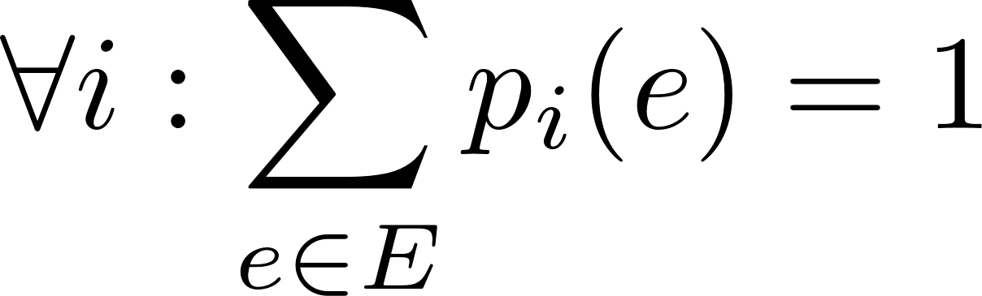
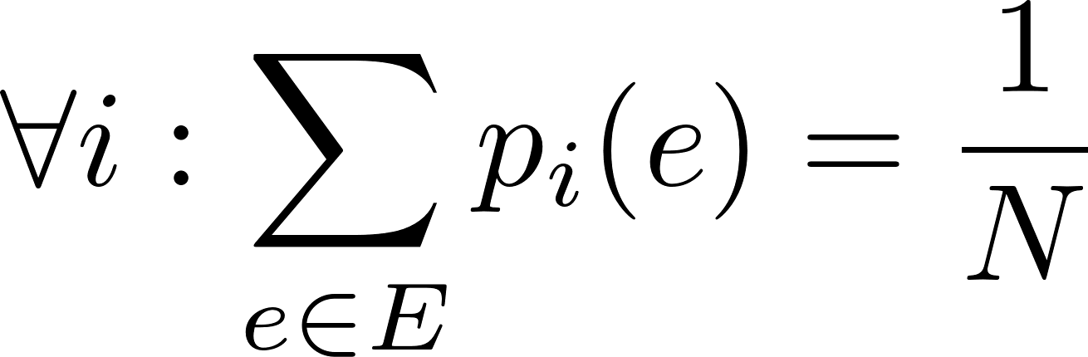
Another Example
t₁, t₂, … t_{N}
t₁, t₂, … t_{N}
t₁, t₂, … t_{N}
1
N
1
N
OR
1
N
s₁, s₂, … s_{N}
s₁, s₂, … s_{N}
s₁, s₂, … s_{N}
Two Nash Equilibria:
Social cost = N
Social cost = 1 = Cent. Optimum

Slide 9
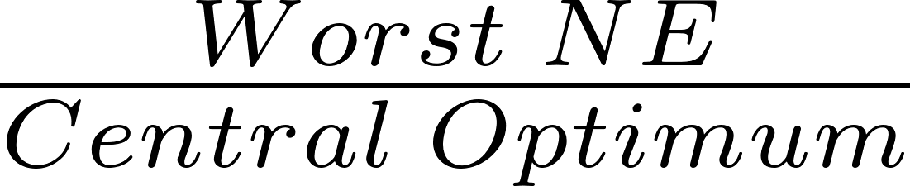
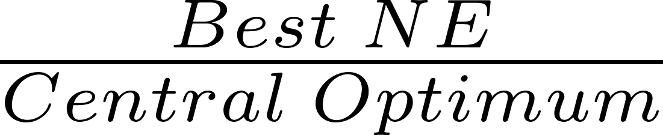
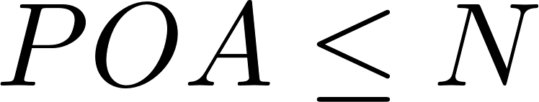
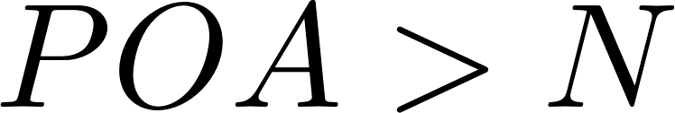
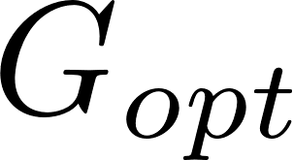

Price of Anarchy & Price of Stability
To underline the gap which can arise between the best centralized solution and the worst NE,
researchers introduced the term Price of Anarchy which is defined
POA :=
In their work, instead, the authors focus on the complementary concept, which they call
Price of Stability defined as
POS :=
Lemma: For the Connection Game:
Pf: Assume , then by the pigeon hole principle there is a player that pays more
than the cost of the optimal solution . But then could deviate by purchasing the
whole , which surely satisfies the connection requirement and, as assumed, would
reduce his total payments

Slide 10
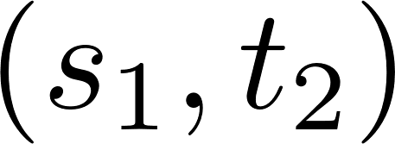
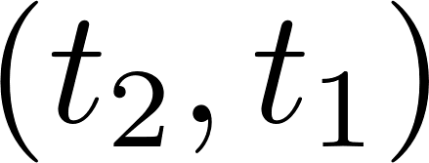
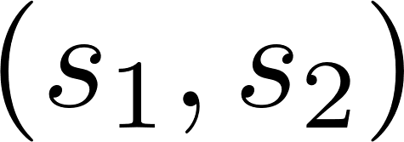
NE may not Exist!
s₁
1
Assume that a NE exists. Then w.l.o.g., by previous
forest property let
  can be paid only by agent 1, likewise
can only be paid by agent 2.
What about edge ?
t₂
1
1
s₂
t₁
1
s₁
1
t₂
  No one would ever paid for it: by the sake of cont. let agent one start contributing to it, but then..
1
1
He would prefer to deviate to since it allows him to connect his terminals paying 1.
Hence no equilibria at all in this graph.
s₂
t₁
1
Notes:
- Gp cant be smaller

Slide 11



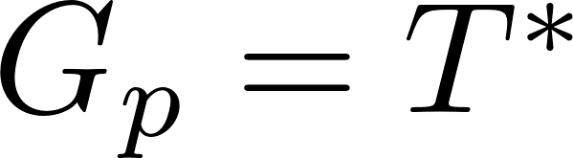
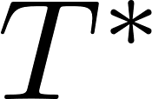
SSG
A Single Source Game is a game (network) in which all players share a common terminal
, and in addition, each player has exactly one other terminal
t₃
We show that every SSG has a NE of POS=1
  I.e. we need to find a strategy
  s.t. is a NE and . Where is the minimum
  cost Steiner tree for the network
s
t₁
t₂

Slide 12
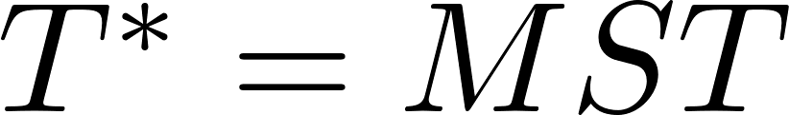
Minimum Spanning Tree
Special Case: every node is a terminal
s
1
4
t₁
Each player pays only for the edge upon him
that lies in , then
is a Nash Equilibrium: since if agent wants to deviate then it means that there exist an alternative path from to cheaper than the one in , cont.
t₂
strategy
5
3
t₃
Does this work for any SSG?
Notes:
Of course no, if we have other non terminal nodes this strategy could lead to unconnected terminals and also the MST is not an optimal solution in this case.

Slide 13
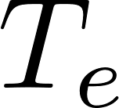
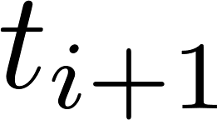
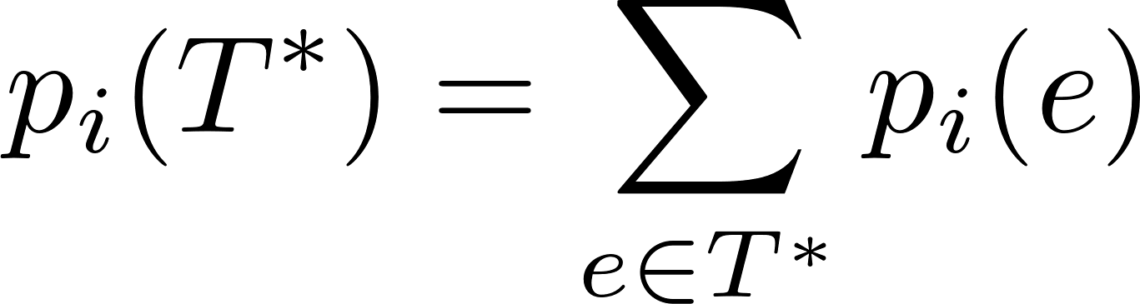
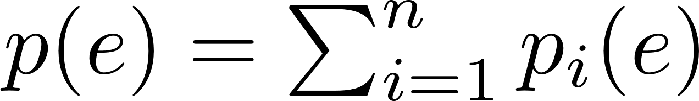
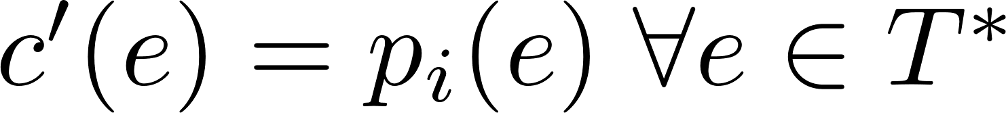
A Procedure for (notation & idea)
Assume given rooted at
Let be the subtree of disconnected from when edge is removed
Let
Let
We present a procedure to determine payment strategies by considering edges in reverse BFS and by paying for the whole before paying for
is upper bounded by the cost that would face if deviates in the final solution:

Slide 14
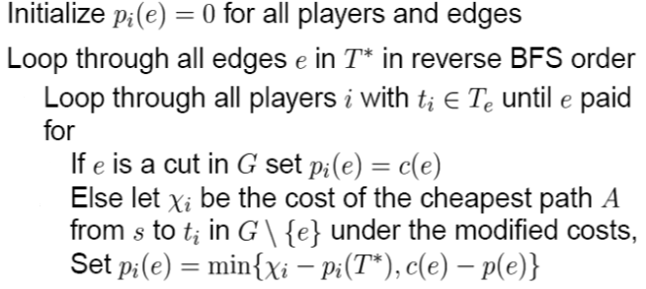
A Procedure for
Remark1 : we never allow player to contribute so much to that his total payments exceed the cost of connecting to
Remark2 : the algorithm constructs payments only to edges in

Slide 15
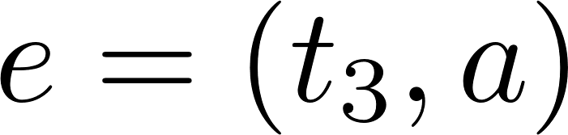
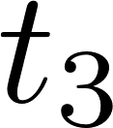
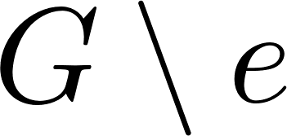
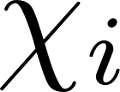
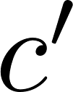

Example
Consider the previously example with weighted edges:
t₃
3
$$T^{∗}$$
s
c
1
2
2
2
2
s
1
2
b
c
a
b
3
2
1
1
1
a
3
t₁
t₂
t₁
t₂
t₃
1
Rev BFS: , only contributes to the edge, not a cut hence compute
cheapest alternative path in of cost under modified cost function
s
2
then
2
2
b
c
a
1
1
1
Hence player 3 fully pays for
3
t₁
t₂
t₃
The same applies to each edge on top of

Slide 16
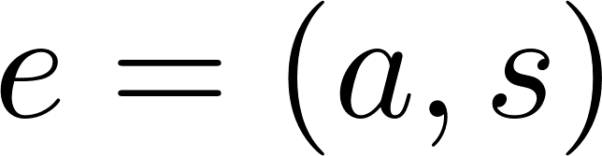
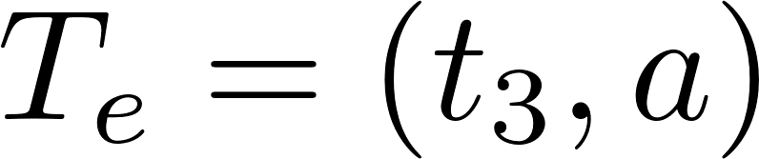
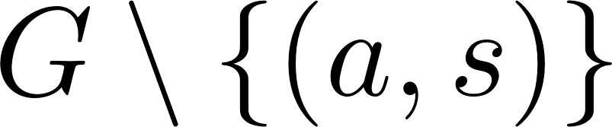
Example (2)
Now not a cut set, still only player 3 contributes to the edge, the shortest path remains equal in , thus . Again, player 3 does buy the edge. The same argument is extended to the other players
s
2
2
2
b
c
a
1
1
1
t₁
t₂
t₃
Therefore . Is a NE? Yes, since a player deviates if and only if there is a shorter path from the terminal to s. Which does not exist by minimality of
Indeed, this is true for any SSG
Notes:
But this was quite a simple example, -> true in general?

Slide 17
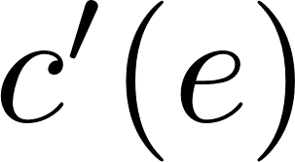
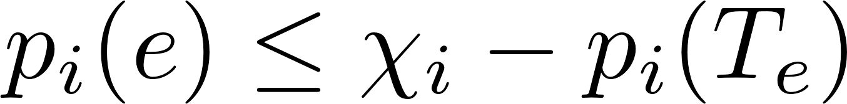
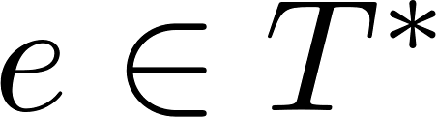
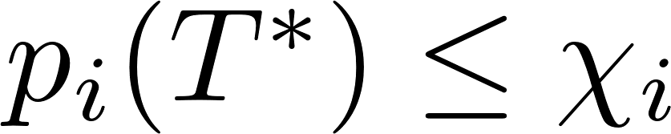
Claim: The set of payments produced by the algorithm is a Nash Equilibrium.
Consider the payment of a player to edge . The cost function reflects how much would pay if he deviates in the final solution on :
However, it is the case that . This is true for any , thus
: i.e. we never allow to pay more than
Therefore It is never in player ‘s interest to deviate, this is true for all players and edges
NO! We need to ensure that
To guarantee connection requirements
Notes:
-Now we go more abstract by proving the results concerning SSG
This step is not taken into account from the authors, but is needed otherwise for how we defined the game, if a player is not connect he incurs into an infinite
Penality!

Slide 18
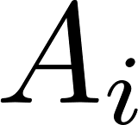

Theorem: the algorithm fully pays for
Idea: Assume by cont. that an edge not completely paid. Than each of the contributors of has an alt. path which explains why he didn’t pay
We can use a carefully selected subset of these paths to construct a tree which spans all the terminals and the origin and which is cheaper than
Proof: Let be the alternative path for player of cost . If more of such paths exist, choose the one that has more ancestors of in .
We need the following result on the structure of

Slide 19














The Structure of
Lemma: Let be one of such paths. Then there are s.t.:
Proof: Assume not, then it has to come back into : call the node on the intersection .
Let and define: the first part of in and the part in that lands
into . Moreover define and .
W.m.a that lies over (othw trivial proof) as showed in the figure:

Slide 20




To prove the lemma we need to show that :
By definition of :
Consider payments along : every time hence, as shown
since it cant cost less than
the shortest path
Since we have that
Since has less ancestors in than it cant be part of . QED
`

Slide 21
















The algorithm fully pays for
We had supposed that
We show how to rewire to w/o decreasing agents payments, contradicting minimality of
For each player in we call the deviation point the highest ancestor of in .
Let be the set of deviation points that do not have any other deviation point
as their ancestors.
All players associated w/ a deviation point in , deviates to while the others keep paying the same edges.
No players increases his payments
Define the tree rooted at if

Slide 22

The algorithm fully pays for
Consider the Tree composed by every and , connected by the respective alternative paths. Clearly this tree spans through all terminals
It remains to show that this tree is fully bought:
  By previous lemma, alternative paths do not re-enter so their cost is fully bought by their respective deviating players
  Consider any edge . By definition of , and of how we designed our tree, no terminal of deviates inside, hence every edge is fully bought.
We have then found a cheaper tree than that connects all terminals

Slide 23





Approximation
Finding the minimum cost Steiner Tree is an NP problem
Our construction, even if mathematically ensure us the existence of NE with POS=1
is infeasible in practice
Thm: Given an α-approximated min Steiner Tree for any there is a polynomial time algorithm which computes a -approximated NE over s.t.
Proof idea: use the same argument introduced in the last theorem to find an approx. NE over a cheaper tree than

Slide 24

Summary & Extensions
We have shown how some of the real world networks are, due to their nature,
preferably modeled using a selfish approach instead of a classical one
  Focusing on a specific model: The Connection Game, we proved that for some specific instances, namely, the Single Source Games, we can always expect the existence of an equilibrium whose cost is equal to optimal centralized solution
  Moreover there exists a computationally tractable procedure that outputs a
  -approximated NE on a near optimal centralized solution
All these results can be proven to be true for the directed version of the SSG
and also when each player would rather stay disconnected from the source if his payments
exceed a given
Notes:
In which players want to connect from t_i to s (argument similar, requires a different definition of D)
Follows directly, just add for each i another terminal which is directly connected to ti and cost 0 and to s with cost max(i)

Slide 25


Other Extensions? Multi-Source Games
Authors gives also results for the general case of many sources and more than one terminals
Since as shown, in this scenario NE existence is not guaranteed, we need again to look for approximations, in particular:
  There exists a -approximate NE which costs is equal to OPT
  There exists a poly time algorithm that finds a -approx. NE that costs at most 2-OTP

Slide 26
Questions?
Thank for your attention!

